Slide 1
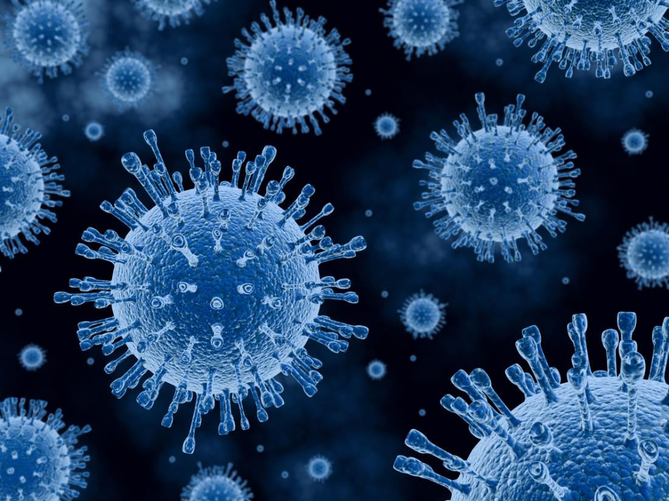
Medical Virology
Fredrick kithome ©|BSC/MLS
Notes:
1

Slide 2
LEARNING OUTCOMES
At the end of the unit, the student should be able to:
Discuss the classification of virus
Describe the viral cell structure.
Explain viral physiology, growth, and pathogenesis.
Describe viral genetics.
Discuss antiviral chemotherapy and Drug Resistance.
Understand the interactions between viruses and the host immune system
Understand selected viral diseases including; HIV, Hepatitis, Measles, Parainfluenza, Mumps, Polioviruses, Enteroviruses, Rhinoviruses, Viral hemorrhagic fevers, and Viral encephalitis.

Slide 3
OVERVIEW
Virology is the study of viruses.
Viruses are the smallest known infective agents and are perhaps the simplest form of life known.
It causes many infectious diseases in man and animals. it is therefore necessary to recognize them as causative agents in certain infections.
A virus is an infectious agent that is minimally constructed of two components:
A genome is either ribonucleic acid (RNA) or deoxyribonucleic acid (DNA), but not both, and
A protein-containing structure (capsid) designed to protect the genome
An envelope composed of a protein-containing lipid bilayer, whose presence or absence further distinguishes one virus group from another

Slide 4
CHARACTERISTICS OF VIRUSES
Characteristics of Viruses:
Viruses are obligate intracellular infective agents
Virus particles contain an integral core containing either DNA or RNA covered by a protein coat.
The viruses do not contain nucleus, cytoplasm, ribosomes or mitochondria
The viruses have no metabolic activity outside the living cells as they lack enzymes.
Viruses do not undergo binary fission. They replicate in a very complex manner
Viruses do not grow on inanimate or artificial culture media
Viruses are resistant to antibiotics.

Slide 5
GENERAL PROPERTIES OF VIRUSES
A. MORPHOLOGY OF VIRUSES:
I. Size: Viruses are the smallest intracellular parasites. They range from 20 to 300 nm in diameter. The smallest virus is parvovirus (20nm) and the largest is the small pox virus (300nm)
II. Shape: The viruses have different shapes like rod shape, bullet shape, sphere or brick shaped The shape of the virus is determined by the arrangement of the protein coat of the virus'.
III. Structure: The extracellular infectious virus particle is called as virion. The virion is made up of central nucleic acid (genome) which is DNA or RNA. This is surrounded by the protein coat (capsid). Both together are called as nucleocapsid. The capsid is made up of repeating units of proteins called as capsomeres. Some of the viruses have an envelope around the capsid.
IV. Symmetry: The arrangement of capsomeres gives the virus the symmetry. There are three forms of symmetry in viral capsids
a. Icosahedral symmetry (cube like)
b. Helical symmetry (capsomeres are arranged as hollow coil)
c. Complex symmetry

Slide 7
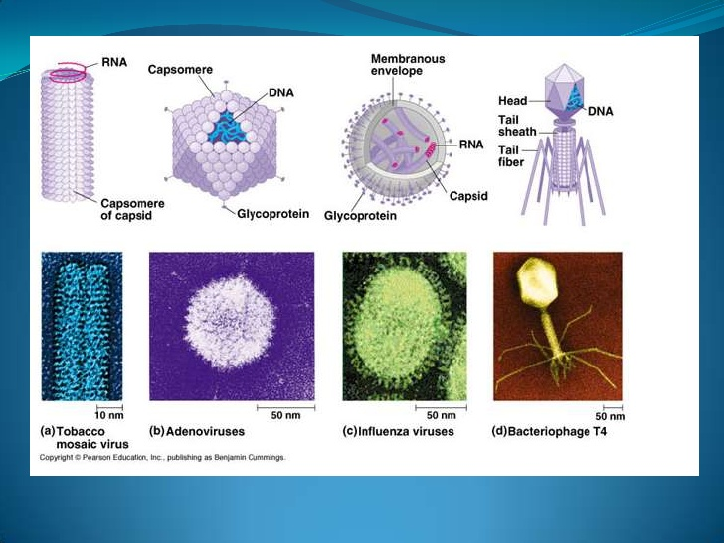

Slide 8
B. CHEMICAL PROPERTIES
1.Nucleic Acid :Viruses contain only one kind of nucleic acid.DNA or RNA.
2. Viral protein and Lipids. Viruses contain protein which makes up the capsid.It protects the nucleic acid. Enveloped viruses contain lipids.
C.SUSCEPTIBILITY TO PHYSICAL AND CHEMICAL AGENTS
A.Temperature :Most viruses are heat labile and are inactivated within seconds at 56ºc,minutes at 37ºc,and days at 4ºc.
B.pH :The viruses remain viable in a pH range of 5-9,but are killed by extreme acidity and alkalinity.
C.Lipid solvents: Chloroform, ether and detergents destroy all enveloped viruses which contain lipoprotein envelopes.
D. Disinfectants :Most viruses are destroyed by oxidising agents such as Hydrogen peroxide, hypochlorite,and iodine compounds.
E.Radiations :Viruses are inactivated by sunlight, ultraviolet rays and ionising radiations.

Slide 9
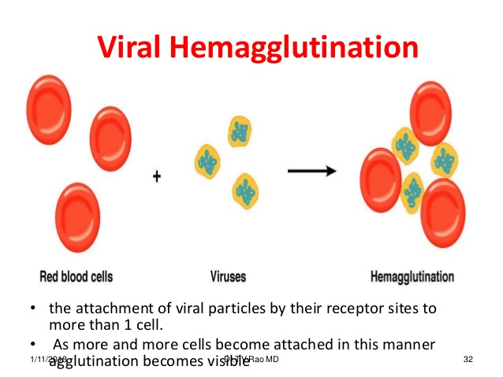
D.VIRAL HAEMAGGLUTININ
Large number of viruses contain haemagglutinin spikes on the capsid or envelope which can agglutinate erythrocytes of different species.
The viral haemagglutinin has special affinity for a different glycoprotein located in the receptor areas on the surface of erythrocyte. The haemagglutination reaction is specifically inhibited by the antibody to the virus. HI is routinely used for detecting antiviral antibody in diagnosis and research.

Slide 10
E. REPLICATION OF VIRUSES
Due to lack of biosynthetic enzymes, viruses replicating by taking over the biochemical machinery of the host cell to synthesis virus specific macromolecules required for the production of virus progeny.
The replicative cycle can be divided into six sequential phases.
1.Adsorption/Attachment
2.Penetration
3.Uncoating
4.Biosynthesis
5.Maturation/Assembly
6.Release.

Slide 11
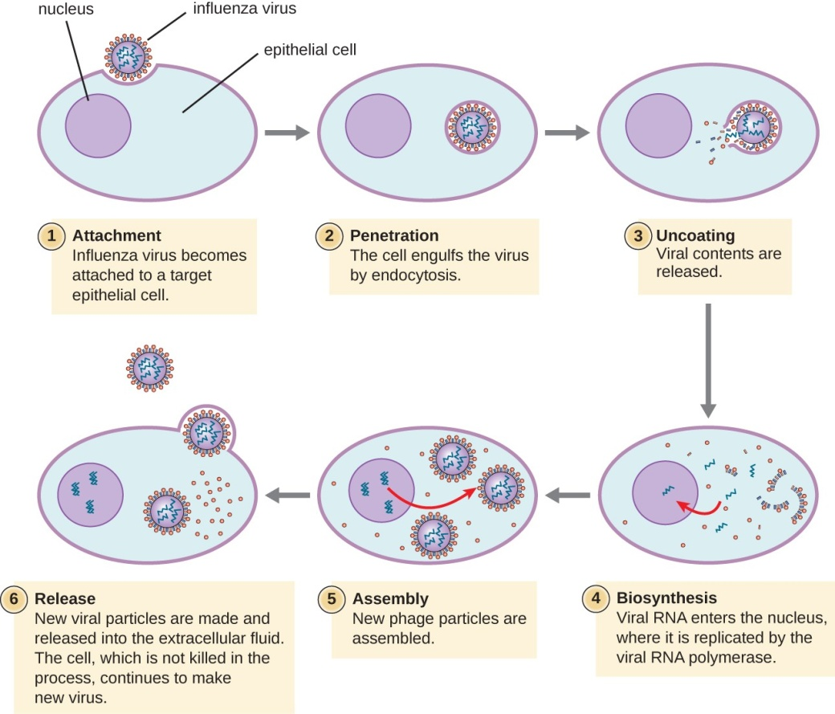
Viral replication phases

Slide 12
VIRAL REPLICATION: THE ONE-STEP GROWTH CURVE
Eclipse period
Following initial attachment of a virus to the host cell, the ability of that virus to infect other cells disappears.
This is the eclipse period, and it represents the time elapsed from initial entry and disassembly of the parental virus to the assembly of the first progeny virion.
During this period, active synthesis of virus components is occurring.
The eclipse period for most human viruses falls within a range of 1 to 20 hours.

Slide 13
Exponential growth
The number of progeny virus produced within the infected cell increases exponentially for a period of time, then reaches a plateau, after which no additional increase in virus yield occurs.
The maximum yield per cell is characteristic for each virus-cell system and reflects the balance between the rate at which virus components continue to be synthesized and assembled into virions, and the rate at which the cell loses the synthetic capacity and structural integrity needed to produce new virus particles.
This may be from 8 to 72 hours or longer, with yields of 100 to 10,000 virions per cell.

Slide 14
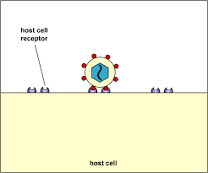
STEPS IN THE REPLICATION CYCLES OF VIRUSES
1. Adsorption
The initial attachment of a virus particle to a host cell involves an interaction between specific molecular structures on the virion surface and receptor molecules in the host cell membrane that recognize these viral structures.

Slide 15
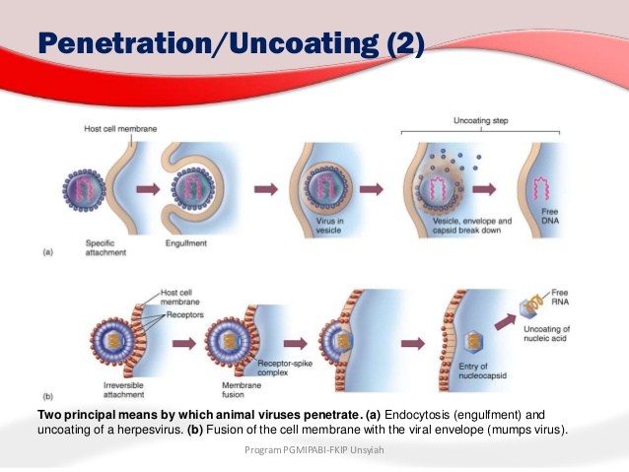
2. Penetration
Penetration is the passage of the virion from the surface of the cell across the cell membrane and into the cytoplasm.
There are two principal mechanisms by which viruses enter animal cells: receptor mediated endocytosis and direct membrane fusion.

Slide 16
Membrane fusion
Some enveloped viruses (for example, HIV, enter a host cell by fusion of their envelope with the plasma membrane of the cell.
One or more of the glycoproteins in the envelope of these viruses promotes the fusion.
The end result of this process is that the nucleocapsid is free in the cytoplasm, whereas the viral membrane remains associated with the plasma membrane of the host cell.
Receptor-mediated endocytosis:
The cell membrane invaginates, enclosing the virion in an endocytotic vesicle (endosome).
Release of the virion into the cytoplasm occurs by various routes, depending on the virus, but, in general, it is facilitated by one or more viral molecules.
In the case of an enveloped virus, its membrane may fuse with the membrane of the endosome, resulting in the release of the nucleocapsid into the cytoplasm.

Slide 17
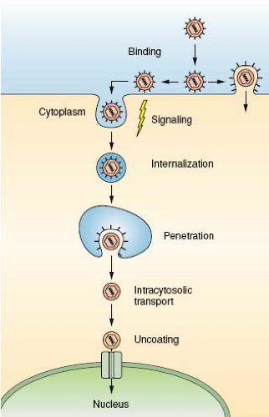
Uncoating
“Uncoating” refers to the stepwise process of disassembly of the virion that enables the expression of the viral genes that carry out replication.
For enveloped viruses, the penetration process itself is the first step in uncoating. In general, most steps of the uncoating process occur within the cell and depend on cellular enzymes.
However, in some of the more complex viruses, newly synthesized viral proteins are required to complete the process.
The loss of one or more structural components of the virion during uncoating predictably leads to a loss of the ability of that particle to infect other cells, which is the basis for the eclipse period of the growth curve

Slide 18
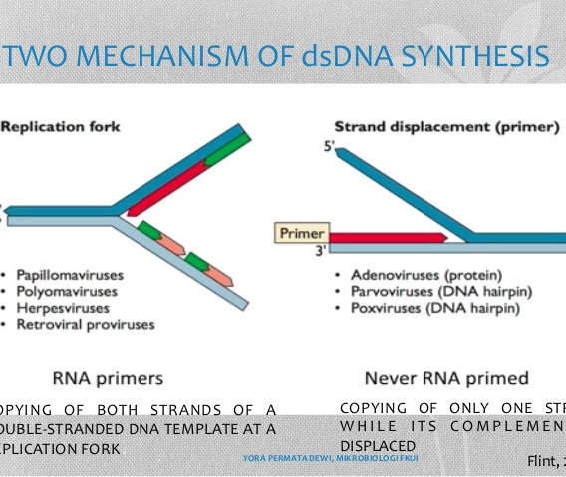
Mechanisms of DNA virus genome replication
Each virus family differs in significant ways from all others in terms of the details of the macromolecular events comprising the replication cycle. The wide range of viral genome sizes gives rise to great differences in the number of proteins for which the virus can code.
In general, the smaller the viral genome, the more the virus must depend on the host cell to provide the functions needed for viral replication.
Other larger DNA viruses, such as poxviruses, provide virtually all enzymatic and regulatory molecules needed for a complete replication cycle.

Slide 19

Mechanisms of RNA virus genome replication
Viruses with RNA genomes must overcome two specific problems that arise from the need to replicate the viral genome and to produce a number of viral proteins in eukaryotic host cells.
First, there is no host cell RNA polymerase that can use the viral parental RNA as a template for synthesis of complementary RNA strands.
Second, translation of eukaryotic mRNAs begins at only a single initiation site, and they are, therefore, translated into only a single polypeptide.
However, RNA viruses, which frequently contain only a single molecule of RNA, must express the genetic information for at least two proteins: an RNA-dependent RNA polymerase and a minimum of one type of capsid protein.

Slide 20
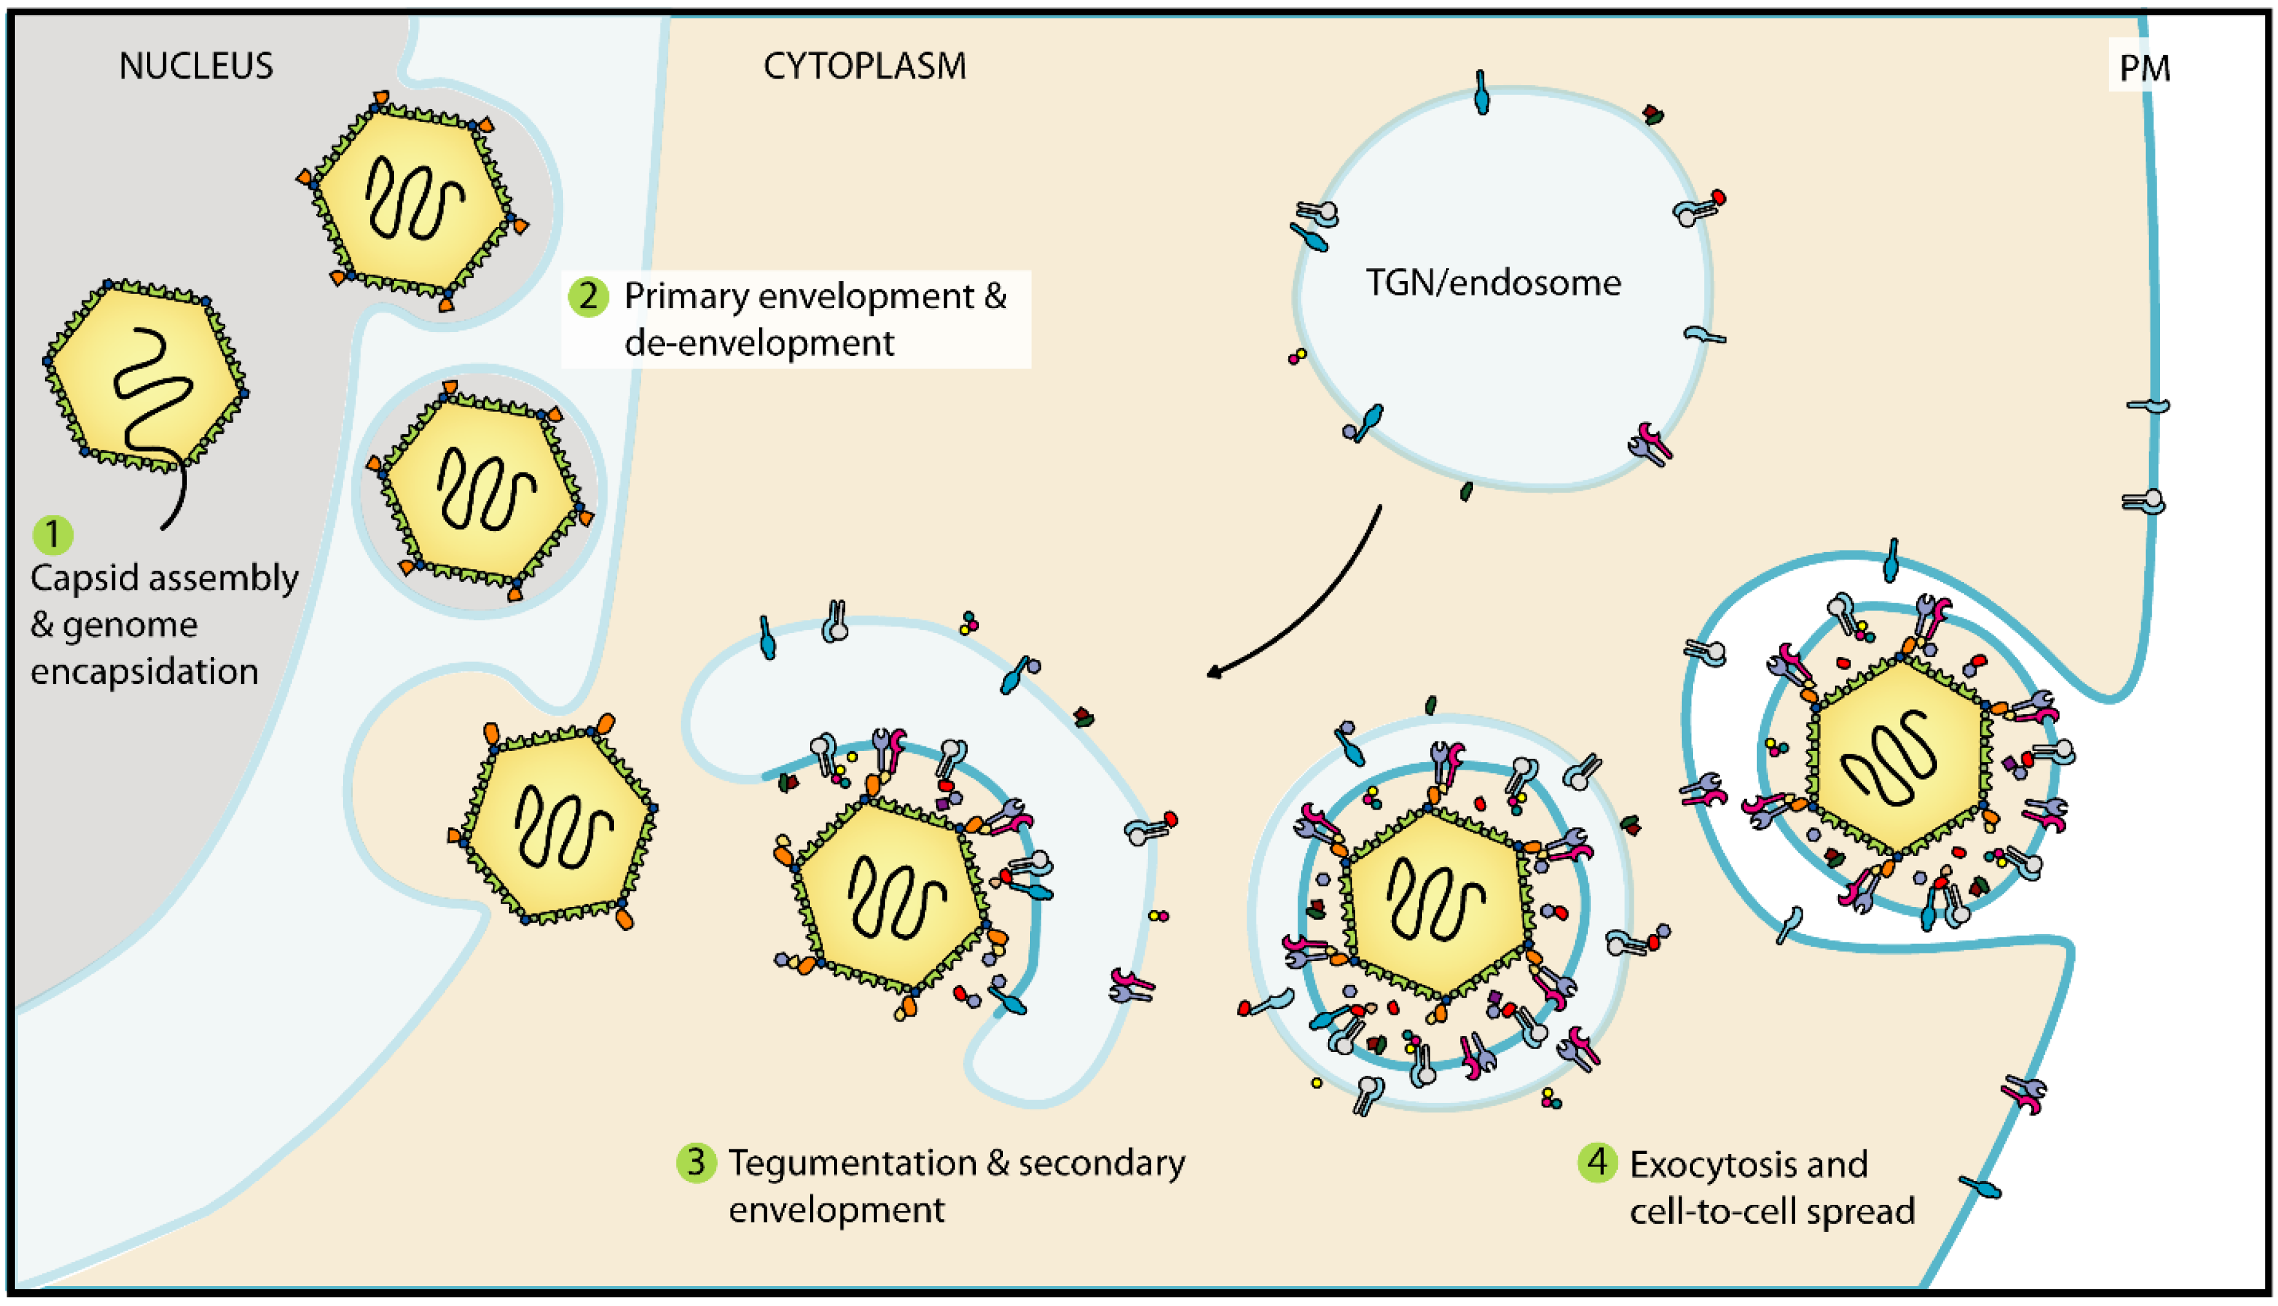
Assembly and release of progeny viruses
Assembly of nucleocapsids generally takes place in the host cell compartment where the viral nucleic acid replication occurs (that is, in the cytoplasm for most RNA viruses and in the nucleus for most DNA viruses).
For DNA viruses, this requires that capsid proteins be transported from their site of synthesis (cytoplasm) to the nucleus.
The various capsid components begin to self-assemble, eventually associating with the nucleic acid to complete the nucleocapsid.

Slide 21
F. Cultivation of viruses:
Viruses multiply only in living cells. Culture is the gold standard for proving viral etiology of any disease. Viruses can be cultured in
animals,
embryonated eggs or
tissue cultures
The growth is identified by neurtralisation tests, other serological tests or by the cytopathic changes brought about in the cell culture by the growing virus,
Animal inoculation: Animals like
Suckling mice,
Rats,
Monkeys
Were used in the past to isolate viruses. But these are largely replaced by tissue culture today. Infant mice are used-in the isolation of arboviruses, and coxsackie viruses.
Animals are observed for disease manifestation or death. The animals are later sacrificed and the tissues are tested for the presence of viruses.

Slide 22
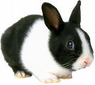
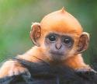
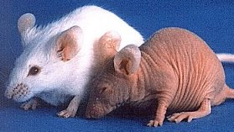
Uses of Animal Inoculation
i. Primary isolation of certain viruses
ii. For the study of pathogenesis, immune response and epidemiology of viral diseases
iii. For the study of oncogenesis.

Slide 23
CLASSIFICATION OF VIRUSES
Viruses began to be classified into groups based on their physicochemical and structural features from the early 1950s.
Nomenclature and classification are now the official responsibility of the International Committee on Taxonomy of Viruses.
Main Criteria Used for the Classification of Viruses
1. Type of nucleic acid: Viruses are classified into two main divisions depending on the type of nucleic acid they possess: riboviruses are those containing RNA and deoxyriboviruses are those containing DNA.
2. Number of strands of nucleic acid: Single-or double-stranded, linear, circular, circular with breaks, segmented.
3. Polarity of the viral genome: RNA viruses in which the viral genome can be used directly as messenger RNA are by convention termed ‘positive-stranded’ and those for which a transcript has first to be made are termed ‘negative-stranded.
4. The symmetry of the nucleocapsid.
5. The presence or absence of a lipid envelope.

Slide 24
Universal System of Virus Taxonomy
A system has been established in which viruses are separated into major groupings called families
Virus family names have the suffix -viridae. Within each family subdivisions called genera.
Genus names carry the suffix -virus.
In four families (Poxviridae, Herpesviridae, Parvoviridae, Paramyxoviridae), a larger grouping called subfamilies has been defined.
Virus orders may be used to group virus families that share common characteristics.
Currently, 24 families contain viruses that infect humans and animals.

Slide 25
Summary classification of DNA & RNA viruses

